Slide 1

Competitive Markets and market interventions
Professor Nico Voigtländer
Management 405: Module 4

Slide 2
Some Logistics
Coffee & Econ Office hours restart next week
Final Exam: March 17-19
3.5 hour time window
Three time windows with guaranteed TA availability:
Friday 3/17: 6-9:30pm
Saturday 3/18: 9am-12:30pm
Sunday 3/19: 12pm-3:30pm

Slide 3
agenda for the class
1. The Economic Way of Thinking
2. Value and Demand
3. Supply and Cost
4. Markets, Pricing and Strategy

Slide 4
Outline of module 4
Introduction to market structures
Perfect competition
Profit maximization of a price taker in the short run
Firm-level and market supply
Long-run competitive equilibrium
Market distortions/regulations
Externalities

Slide 5
Outline of module 4
Introduction to market structures
Perfect competition
Profit maximization of a price taker in the short run
Firm-level and market supply
Long-run competitive equilibrium
Market distortions/regulations
Externalities

Slide 6
the four basic market structures
 | Perfect competition | Monopolistic competition | Oligopoly | Monopoly
Number of Firms
Type of Products Sold
Barriers to Entry
Many
Identical
None
Many
Differentiated
None
Few
Identical or Differentiated
Some
One
Identical or Differentiated
Many
Notes:
Here we start thinking about a firm’s competitive environment or market structure. We categorize market structure using three characteristics:
1. Number of firms: in general, when there are more companies in the market, the market is more competitive.
2. Whether the consumer cares which company made the good: are the goods identical or can the consumer distinguish who made the good? In general, if goods are closer to identical, the market is more competitive.
3. Barriers to entry: if new firms can enter the market easily, the market is more competitive.

Slide 7
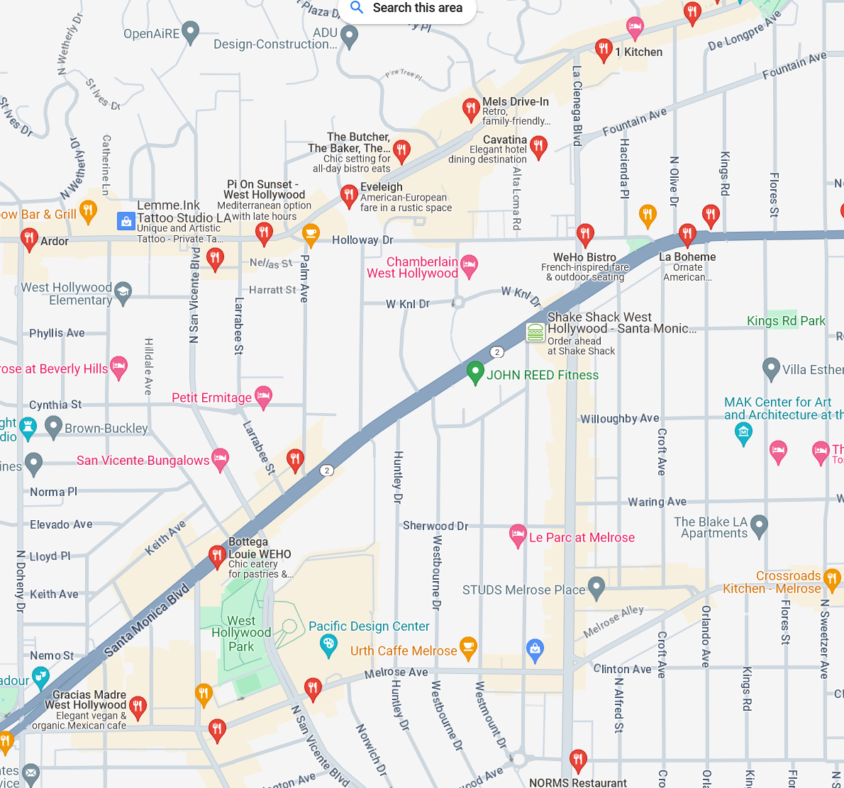
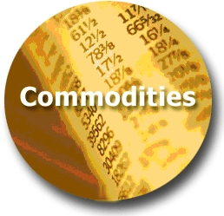



Extent of market power: price takers vs price searchers
TODAY
Least Market Power
Most Market Power
Perfect
Competition
Monopolistic Competition
Oligopoly
Monopoly
(Price Takers)
(Price Searchers)
Restaurants in WeHo
Notes:
Extent of market power. The spectrum runs from price taker (today’s topic) to price searchers with increasing degrees of market power (subject of subsequent sessions):
A perfectly competitive firm has no market power; it has such a small percentage of the market that it can exert no effect on price.
A monopolistically competitive firm, such as gas stations and restaurants, offers a differentiated product and thus faces a downward sloping demand curve – offerings of other firms are not perfect substitutes. There is still intense competition because the products can substitute for each other so the elasticity of demand facing each firm tends to be high. Free entry drives long-run profits to zero.
Oligopolistic markets are cases of few firms. For example, a duopoly is a special case of an oligopoly with only 2 firms. Interesting strategic issues arise here as you need to think hard about your rivals’ response to your firm’s behavior. Entry may be limited.
Monopolistic markets are markets with only one seller, such as utilities in most cities (legal monopoly) or Microsoft (quasi-monopoly, due to demand-side economies of scale, i.e. network effects).

Slide 8
Perfect competition (Price takers)
Number of actual or potential competitors:
Product differentiation:
Entry conditions:
Profit potential:
Examples:
Many small sellers
None
No barriers
Short run: can be positive/negative
Long run: zero economic profit
Agricultural commodities; currency markets; unskilled labor
Notes:
Characteristics of a price taker market. Today we focus on perfect competition. For a market to be perfectly competitive, three conditions must be satisfied:
There are many firms. Thus, the impact of any one firm on the market equilibrium is negligible.
All firms produce an identical product.
There are no barriers to entry.
The implications of these conditions is that firms in perfectly competitive markets are price takers, i.e. they do not have discretion over the price to charge. In the case of price takers, they face perfectly elastic demand (horizontal demand curve), there is no product differentiation, and they cannot deviate in price. Examples include Indian rice producers, sellers of currency, etc. If the firm chooses a price above the market price, the firm will lose all sales. Since the firm can sell as much as it would like at the market price, it has no incentive to sell at a quantity below the market price.
Why study perfect competition? There are 3 main reasons:
You need to understand how perfectly competitive markets around you function. For instance, the bond market, the currency markets, commodity markets, labor markets, etc, where price taking behavior is frequent.
You might have to act in perfectly competitive markets on occasion.
By understanding perfect competition in depth you can come up with ways to make the market in which you operate look more like an imperfect competition market. This is what businesses do – differentiate, raise barriers to entry, gain market power.

Slide 9
Outline of Module 4
Introduction to market structures
Perfect competition
Profit maximization of a price taker in the short run
Firm-level and market supply
Long-run competitive equilibrium
Market distortions/regulations
Externalities

Slide 10
Perfect competition: the market and the firm
Market
Firm (price taker)
P
Market Equilibrium
Market Supply (S)
P
Demand curve d = Marginal Revenue (MR)
P*
Market Demand (D)
Q
Q
Notes:
This slides explain the relationship between the market vs. the firm demand. It shows where the demand a price taker is coming from = market price, determined by the market equilibrium.
Now, let’s turn to see how a price taker maximizes profit in the short run.

Slide 11


Perfect Competition and Farmer Protests
Germany’s government cut subsidies for farmers in 2024.
“The farmers’ association said some farmers stood to lose as much as €10,000 a year from the cuts.”
Statement by Germany’s minister of economic affairs:
“For farmers there is a structural problem: They cannot pass on their production costs because the prices are not made by them.”

Slide 12
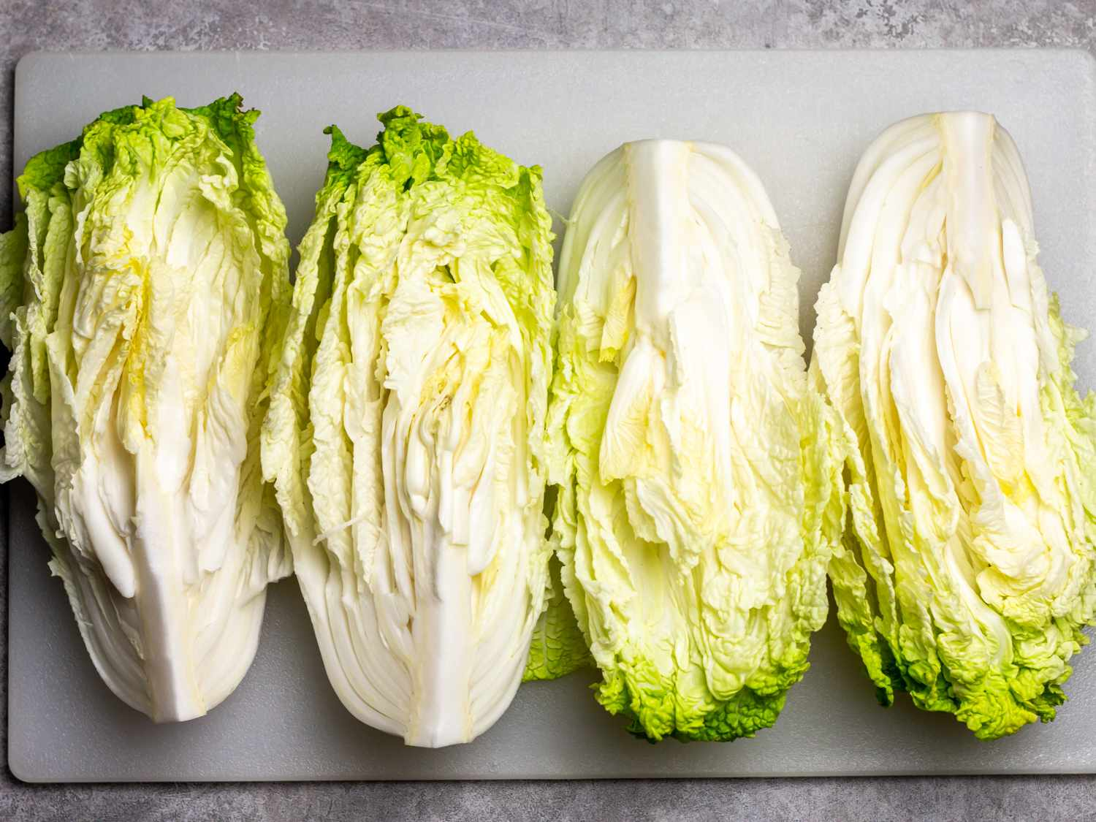

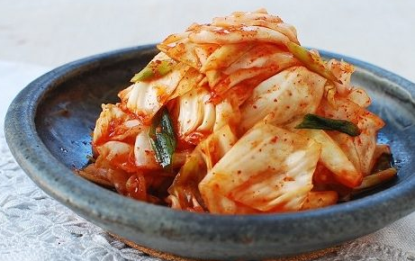
Example: The Yi family
South Korean family moves from California to rural Arkansas to start a family farm
Their goal: grow Korean produce to sell to vendors in Dallas (at market price)
We focus on their production of cabbages (used to make Kimchi)
Notes:
https://www.vulture.com/article/minari-movie-review-a-gentle-immigrant-drama-set-in-u-s.html
https://time.com/5938842/minari-korean-american-farmers/

Slide 13

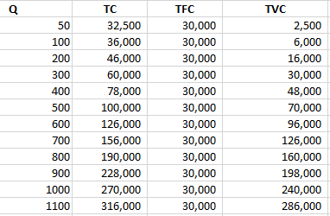

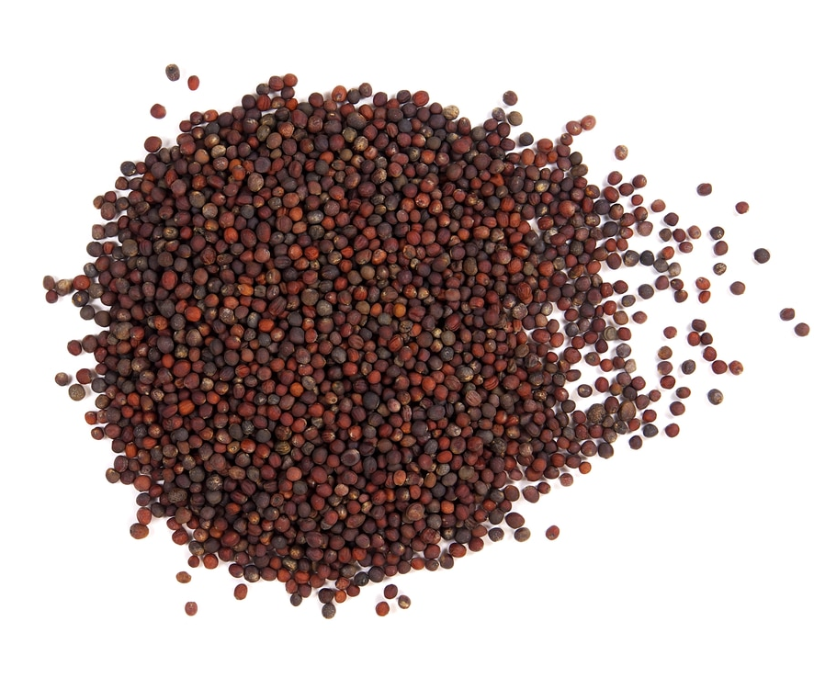
cabBage production costs
d
Yi Family Example
Notes:
Source for the costs: https://ucanr.edu/sites/Farm_Management/files/179212.pdf
Opportunity costs: salary from working somewhere else, estimated at about 15k
Quantity in tons
Fixed Costs: land rent, equipment + opportunity costs
Variable Costs: seeds, water, fertilizers, pesticides
Images: right (water), top left (fertilizers), bottom left (seeds)

Slide 14

cabBage total Cost function
Total cost ($)
Quantity (tons)
Yi Family Example
Notes:
Source for the costs: https://ucanr.edu/sites/Farm_Management/files/179212.pdf
Opportunity costs: salary from working somewhere else, estimated at about 15k

Slide 15
Business Relevance
Key questions:
Should the Yi family operate or not?
How much should the Yi family produce?
We start by analyzing point 2.: profit maximization
Key concept: marginal analysis
Notes:
In bullet number 2: emphasize that no price decision since we are price takers

Slide 16
Price taker profit maximization
Set MR=MC (just like all profit maximizers!)
However, MR is easier to compute in case of price taker:
For a price taker: MR=P (where P is the market price)
P is given (i.e., a firm cannot set the market price)
Only decision that the price taker needs to make:
How much quantity to produce
Find Q* such that P = MC [profit max of a price taker]
Notes:
Any perfectly competitive firm sells at the price set by the market. Perfectly competitive firms then have one decision to make: the quantity to supply.

Slide 17
Price Taker Revenue Conditions
P
$3
3
3
3
Q
10
11
12
13
TR
$30
33
36
39
MR
$3
3
3
3
P
P
The demand curve faced by a price taker is the market price (which in turn equals MR for a price taker)
TR=P∙Q
$30
3
TR = $30
P = MR
Q
Q
10
10

Slide 18
Profit maximization of a price taker: visual representation
Firm revenue,
cost and
profit ($)
TR
TC
(TR has constant slope for a price taker)
Slope of TR = slope of TC
MR = MC
TFC
Maximum profit
Profit=0
Profit = TR-TC
Quantity (Q)
Q*
(Profit is the difference between TR and TC)

Slide 19
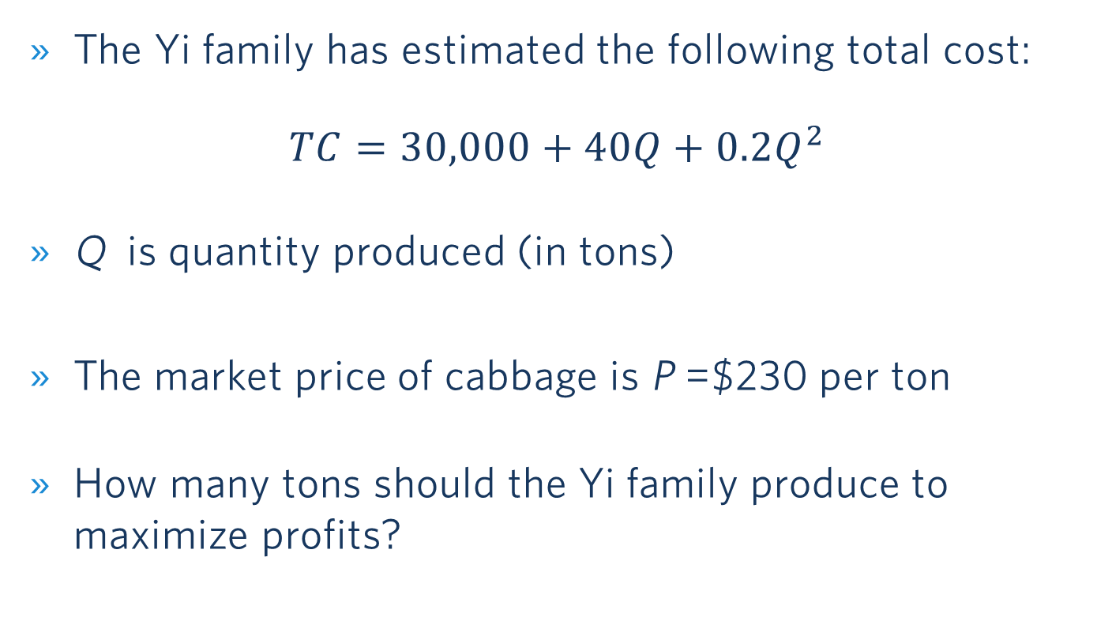
maximizing profit: cabbage production
The Yi family has estimated the following total cost:
$$TC=30,000+40Q+0.2Q^{2}$$
Q is quantity produced (in tons)
The market price of cabbage is P =$230 per ton
How many tons should the Yi family produce to maximize profits?
Yi Family Example
Notes:
Source for the market price (2016): https://www.agmrc.org/commodities-products/vegetables/cabbage

Slide 20
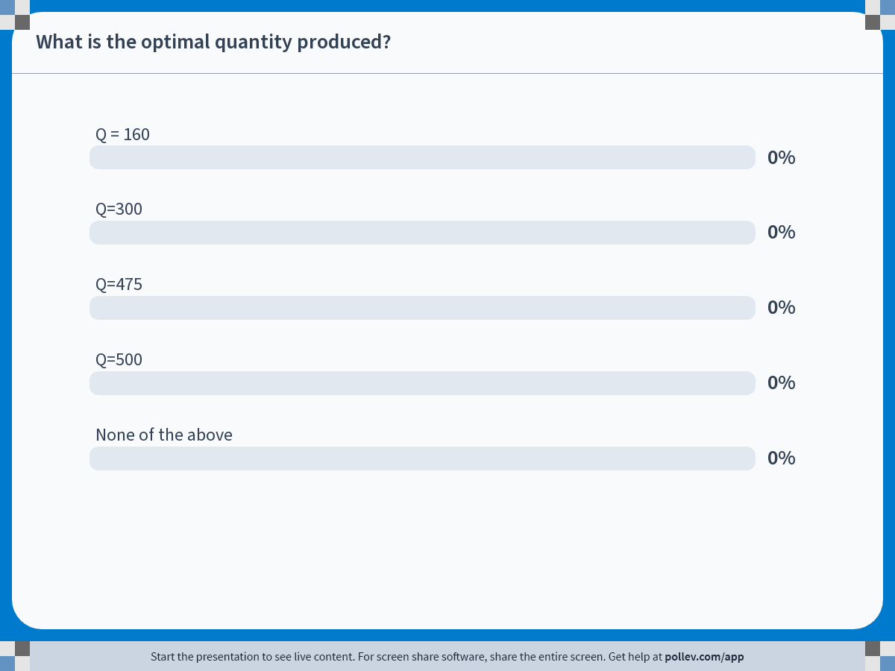
Notes:
Poll Title: Do not modify the notes in this section to avoid tampering with the Poll Everywhere activity. More info at polleverywhere.com/support What is the optimal quantity produced? https://www.polleverywhere.com/multiple_choice_polls/Zwza1GbC7sIapRu20fIpK?state=opened&flow=Default&onscreen=persist

Slide 21
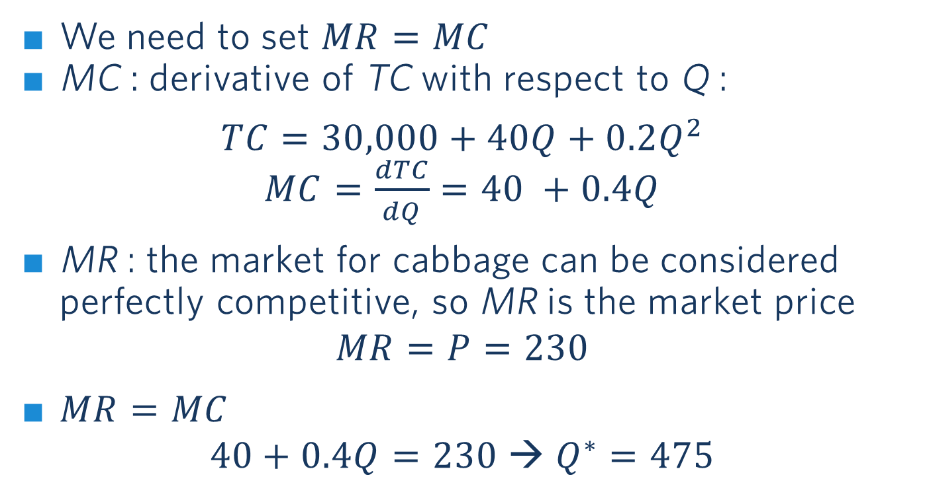
Profit maximizing quantity: solution
We need to set $MR=MC$
MC : derivative of TC with respect to Q :
$$TC=30,000+40Q+0.2Q^{2}$$
$MC=\frac{dTC}{dQ}=40 +0.4Q$
MR : the market for cabbage can be considered perfectly competitive, so MR is the market price
$$MR=P=230$$
$MR=MC$
$$40+0.4Q=230 → Q^{∗}=475$$
Yi Family Example

Slide 22
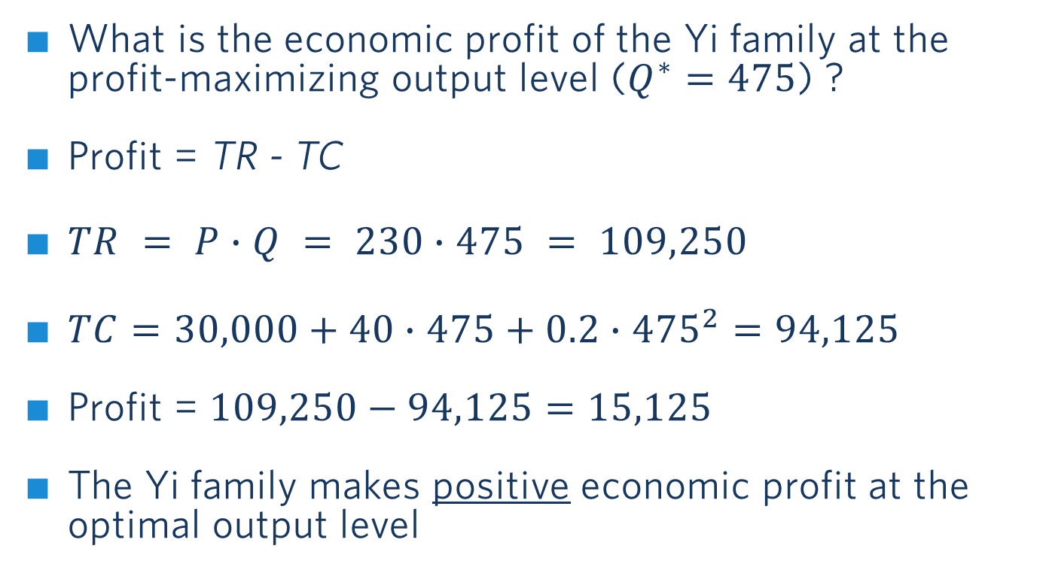
Profit at q*: solution
What is the economic profit of the Yi family at the profit-maximizing output level ($Q^{∗}=475$) ?
Profit = TR - TC
$TR = P∙Q = 230∙475 = 109,250$
$TC=30,000+40∙475+0.2∙{475}^{2}=94,125$
Profit = $109,250−94,125=15,125$
The Yi family makes positive economic profit at the optimal output level
Yi Family Example

Slide 23
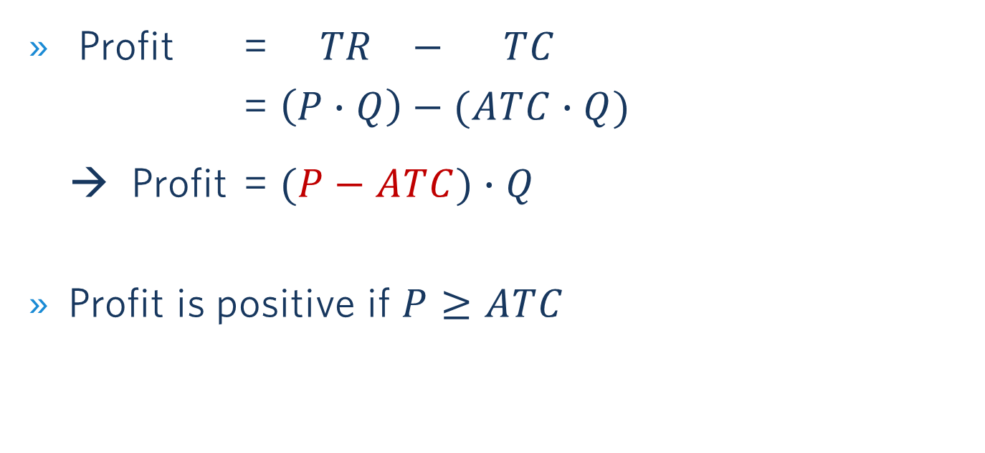
Profits And Average Total Costs (ATC)
Profit = $TR − TC$
= $\left(P∙Q\right)−(ATC∙Q)$
→ Profit = $(P−ATC)∙Q$
Profit is positive if $P≥ATC$

Slide 24
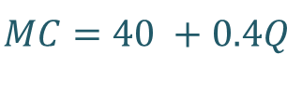

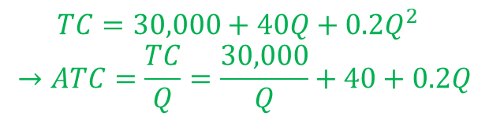
Illustrating Positive Profits of the Yi Family
P
$$MC=40 +0.4Q$$
230
P=MR
Profit
ATC
$$TC=30,000+40Q+0.2Q^{2}$$
$$→ATC=\frac{TC}{Q}=\frac{30,000}{Q}+40+0.2Q$$
40
Q
Q*=475
Profit = $(P−ATC)∙Q$
Yi Family Example

Slide 25
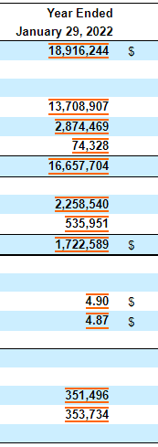
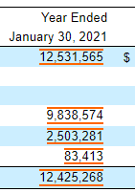
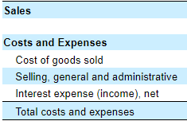


Relationship to Accounting: Ross Stores annual report
$≈$ TVC
Mix FC & VC
Part of FC
$≈$ TC
Notes:
Using Ross Stores Annual report for illustration: https://www.sec.gov/ix?doc=/Archives/edgar/data/745732/000074573222000014/rost-20220129.htm#i84f0090916e6417881836bdad18ed609_64
Highlight the 3 items under “costs and expenses”
Costs of goods sold = variable
Selling, general and administrative = a bit of both (sales commissions would be variable but the CEO salary fixed)
Interest expense (the cost of borrowing money) = fixed

Slide 26

Maximizing profits in the short run (general case)
Positive Profit
Zero Profit
Negative Profit (Loss)
Price & cost ($/unit)
Price & cost ($/unit)
Price & cost ($/unit)
Loss, π <0
ATC
MC
MC
MC
Profit, π > 0
Average total cost ATC
ATC
ATC*
P
d = MR
ATC* = P
d = MR
P
d = MR
ATC*
Q*
Quantity
Q*
Quantity
Q*
Quantity
Profit = $(P−ATC)∙Q$
Notes:
To measure profit, we subtract total cost from total revenue.
Profit = TR – TC
We can rewrite this as:
Profit = P*Q – ATC*Q
Profit = (P – ATC)*Q
This formula determines whether the firm has positive, zero, or negative profit.
Positive profit: In this figure, the firm’s total revenue is the area of the rectangle with height P and width Q*. The total cost is the area of the rectangle with the height ATC* and the width Q*. Because total revenue exceeds total costs at Q*, the firm is earning positive profits. This equation tells us that profit is positive when P>ATC at the profit maximizing quantity Q*.
Zero profit: Here P=ATC (=MC). We know that MC intersects ATC at its minimum.
Negative profit: P<ATC

Slide 27
If profit is negative, should a firm Stop Producing?
Is a firm better off operating at a loss or shutting down and producing zero output?
Stop producing: Long run vs. Short run
Long run: exit the industry
Short run: need to pay for the fixed costs
E.g., land rental contract for the year
We first focus on short-run decisions

Slide 28
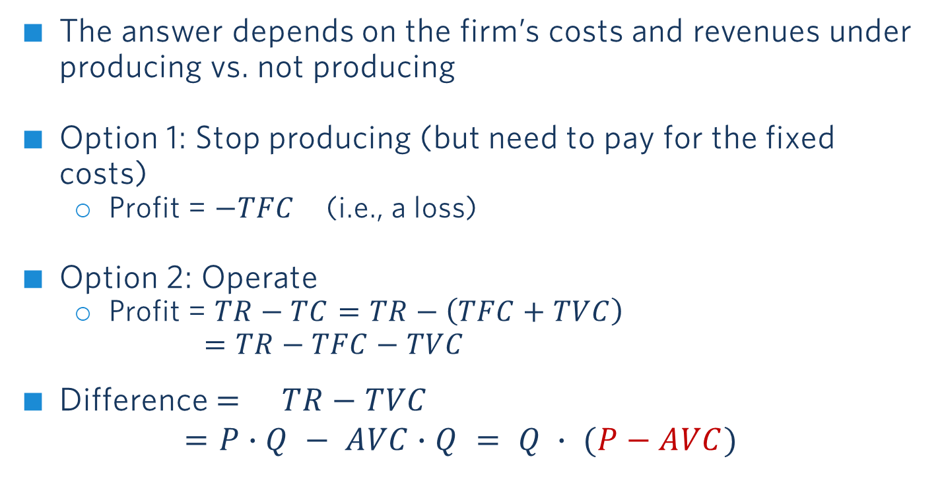
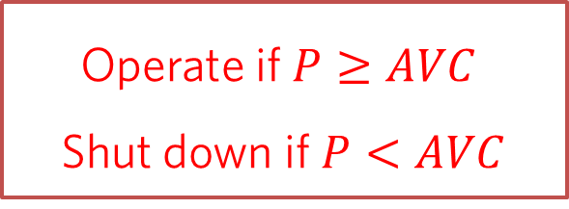
If profit is negative, should a firm shut down in the short run?
The answer depends on the firm’s costs and revenues under producing vs. not producing
Option 1: Stop producing (but need to pay for the fixed costs)
Profit = $−TFC$ (i.e., a loss)
Option 2: Operate
Profit = $TR−TC=TR−\left(TFC+TVC\right)$ $=TR−TFC−TVC$
Difference $= TR−TVC$
$$=P∙Q − AVC∙Q = Q ∙ (P−AVC)$$
Operate if $P≥AVC$
Shut down if $P<AVC$

Slide 29
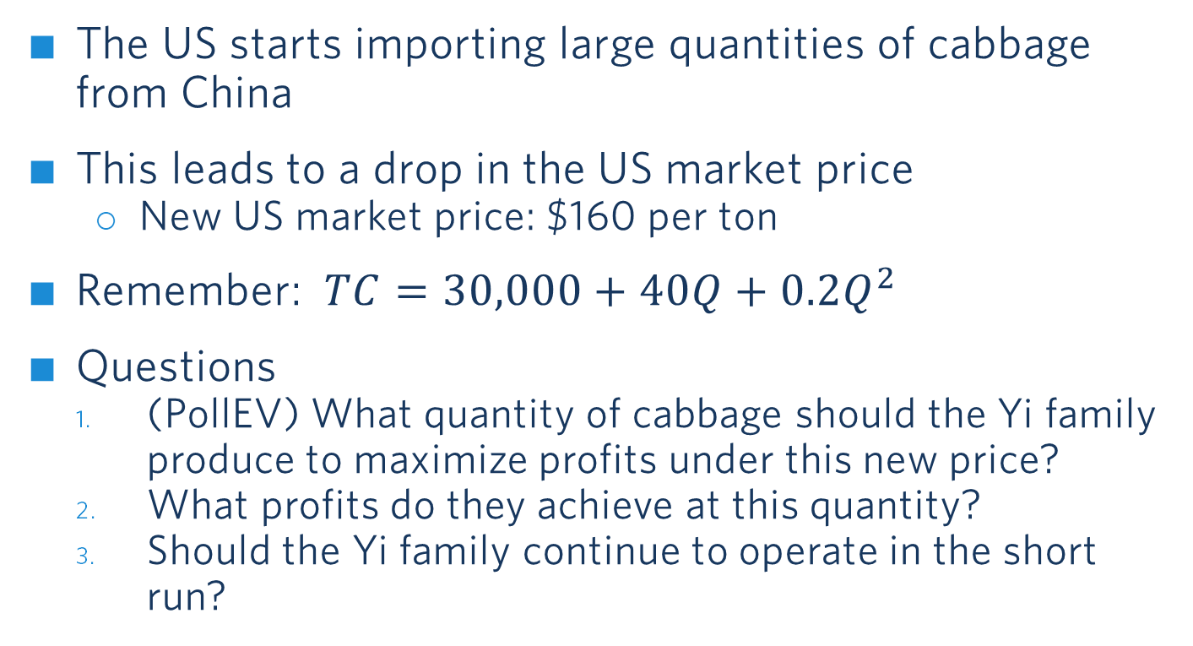
Optimizing in the short run: new market price
The US starts importing large quantities of cabbage from China
This leads to a drop in the US market price
New US market price: $160 per ton
Remember: $TC=30,000+40Q+0.2Q^{2}$
Questions
(PollEV) What quantity of cabbage should the Yi family produce to maximize profits under this new price?
What profits do they achieve at this quantity?
Should the Yi family continue to operate in the short run?
Yi Family Example
(Group Work)
Notes:
Questions 2 and 3 solved by instructor

Slide 30
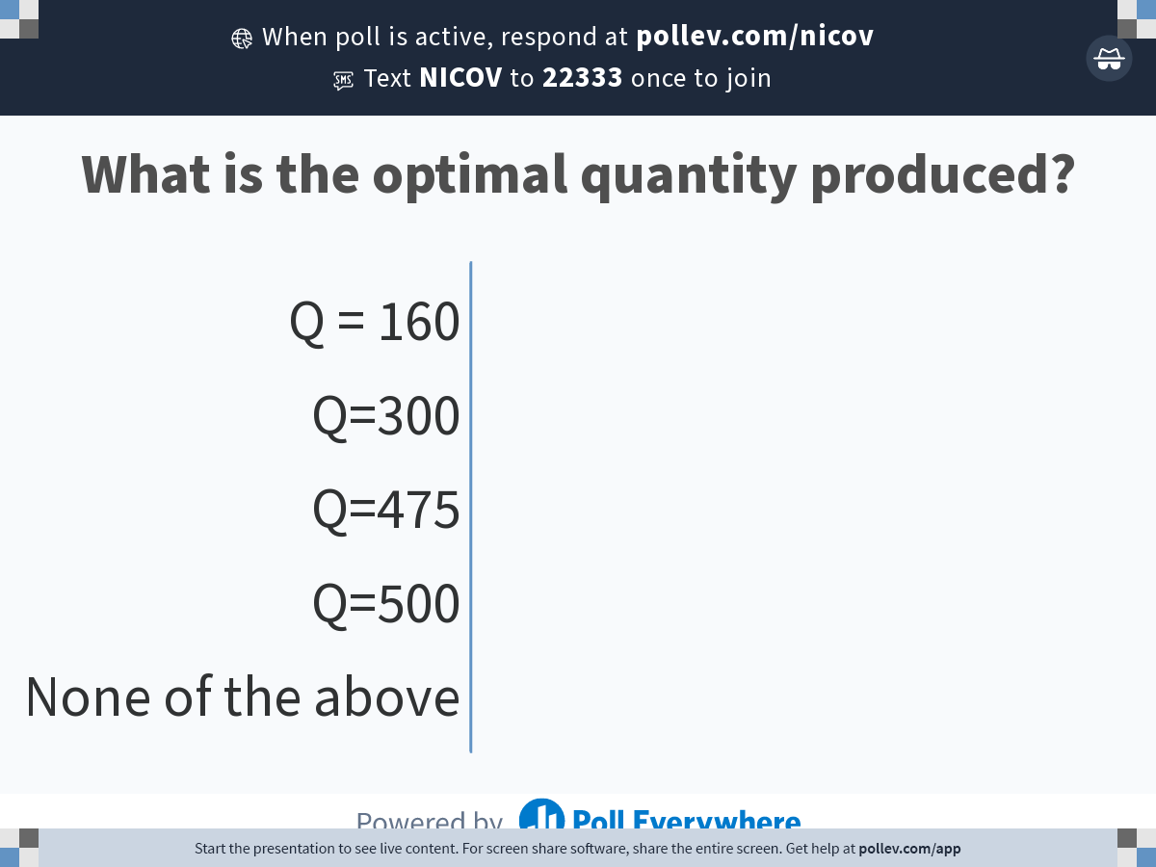
Notes:
Poll Title: Do not modify the notes in this section to avoid tampering with the Poll Everywhere activity. More info at polleverywhere.com/support What is the optimal quantity produced? https://www.polleverywhere.com/multiple_choice_polls/Zwza1GbC7sIapRu20fIpK?display_state=chart&activity_state=opened&state=opened&flow=Default&onscreen=persist

Slide 31
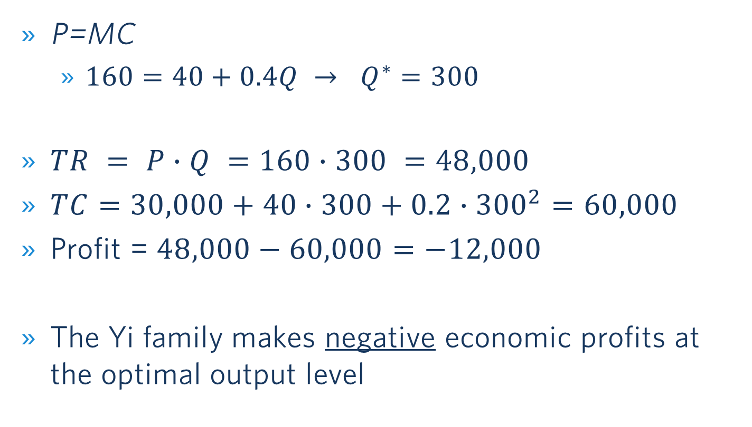
New q* and Profit: solution
P=MC
$160=40+0.4Q → Q^{∗}=300$
$TR = P∙Q =160∙300 =48,000$
$TC=30,000+40∙300+0.2∙{300}^{2}=60,000$
Profit = $48,000−60,000=−12,000$
The Yi family makes negative economic profits at the optimal output level
Yi Family Example

Slide 32
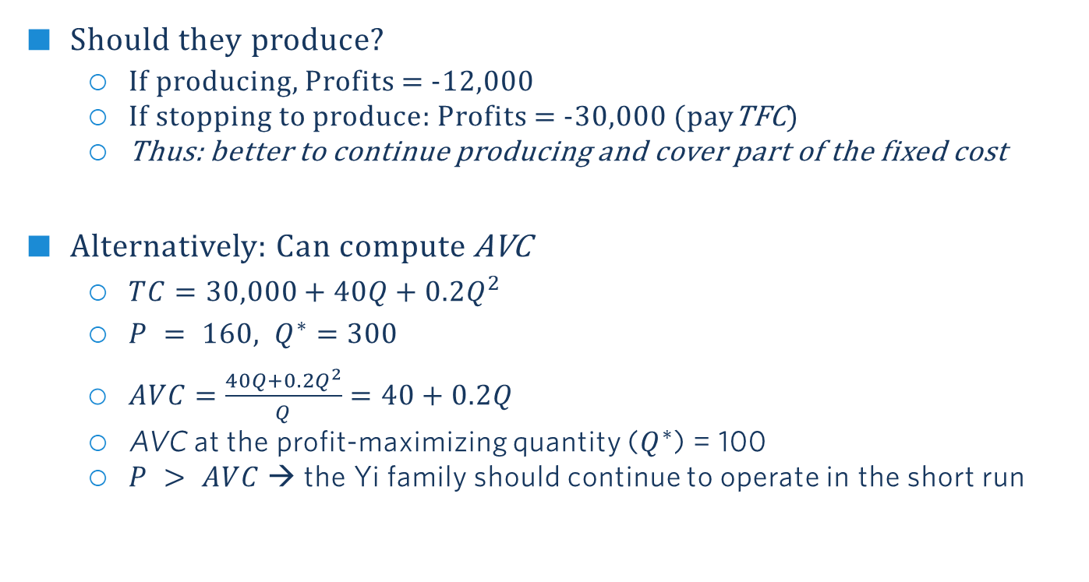
Decision to operate: Solution
Should they produce?
If producing, Profits = -12,000
If stopping to produce: Profits = -30,000 (payTFC)
Thus: better to continue producing and cover part of the fixed cost
Alternatively: Can compute AVC
$TC=30,000+40Q+0.2Q^{2}$
$P = 160, Q^{∗}=300$
$AVC=\frac{40Q+0.2Q^{2}}{Q}=40+0.2Q$
AVC at the profit-maximizing quantity ($Q^{∗}$) = 100
$P > AVC$→ the Yi family should continue to operate in the short run
Yi Family Example

Slide 33
high price: Positive Profits in the Short run
AVC
$/Q
MC
ATC
Profit
Phigh
P=MR
Q
Q*
Optimal output is where MC = MR = P. This occurs at Q*. At that output positive economic profits are being made because P > ATC.
Notes:
Recap slides, say that we show them in the general case (MC not linear)
Context: At the beginning can sell at a very high price… Profit maximization in the short run. This figure depicts positive profit in the short run.

Slide 34
low price: Operating at a loss in the short run
AVC
$/Q
MC
ATC
Plow
Loss if Operating
P=MR
Q
Q*
Negative economic profits (losses) are being made because P < ATC.
But P ≥ AVC → The firm should continue to operate in the short run.
Notes:
Then the price decreases… This figure depicts a firm that should operate at a loss in the short run.
Should we operate? Here P<ATC so there is a loss but the real test is whether P$≥$AVC. There is a range where P$≥$AVC and there is a positive contribution. You want to operate in that range.

Slide 35
Very low price: shutting down in the short run
AVC
$/Q
MC
ATC
Loss if shutting
Down (=Fixed Cost)
Pvery low
P=MR
Q
Q*
Negative economic profits (losses) are being made because P < ATC.
And P < AVC → The firm should shut down, operating does not positively contribute.
Notes:
The price continues to decrease… This figure depicts a firm that should shut down in the short run.
Here P<ATC so there is a loss but the real test is whether P$≥$AVC. Here P<AVC (always) so the firm is better off shutting down. Operating does not positively contribute.

Slide 36
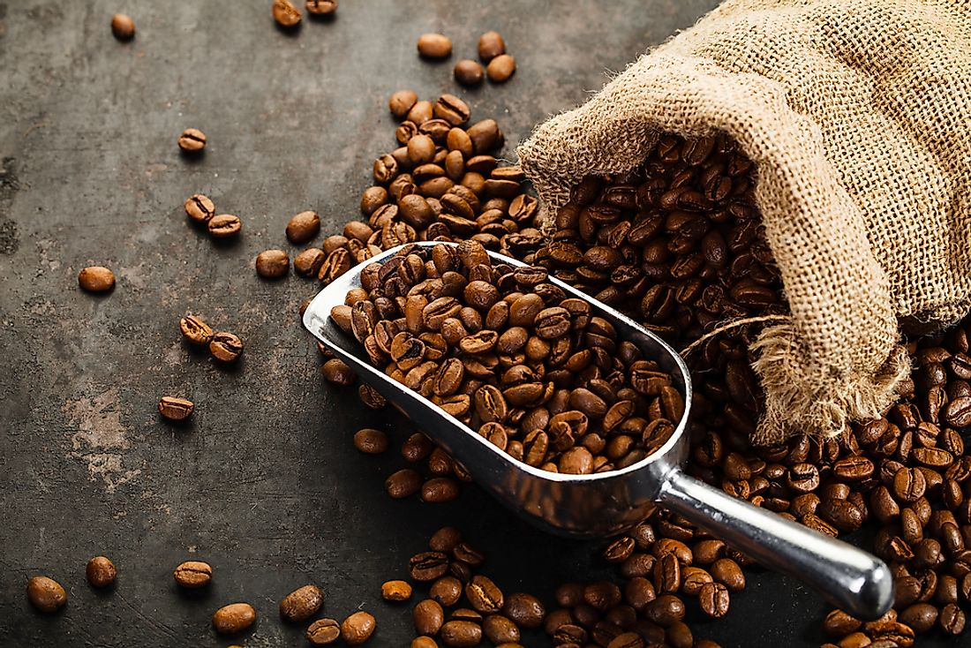
Coffee bean producer
Your firm is a price taker in the coffee bean market.
You have recently optimized your output level so as to maximize profits in the short run.
Information:
AVC = $12
ATC = $15
MC = $10
Should you continue to operate in the short run?
Poll Break

Slide 37
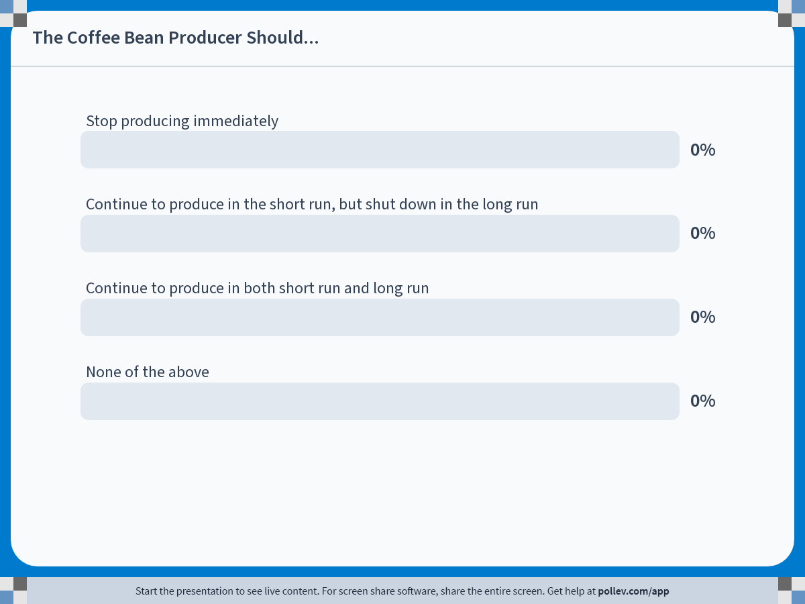
Notes:
Poll Title: Do not modify the notes in this section to avoid tampering with the Poll Everywhere activity. More info at polleverywhere.com/support The Coffee Bean Producer Should... https://www.polleverywhere.com/multiple_choice_polls/sry3DICjteteqyV1Ny4gL?state=opened&flow=Default&onscreen=persist

Slide 38
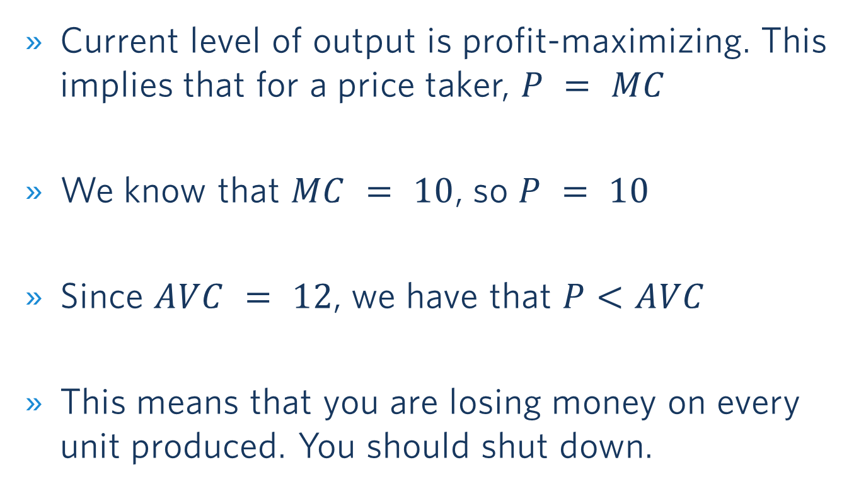
Coffee bean producer: Solution
Current level of output is profit-maximizing. This implies that for a price taker, $P = MC$
We know that $MC = 10$, so $P = 10$
Since $AVC = 12$, we have that $P<AVC$
This means that you are losing money on every unit produced. You should shut down.

Slide 39
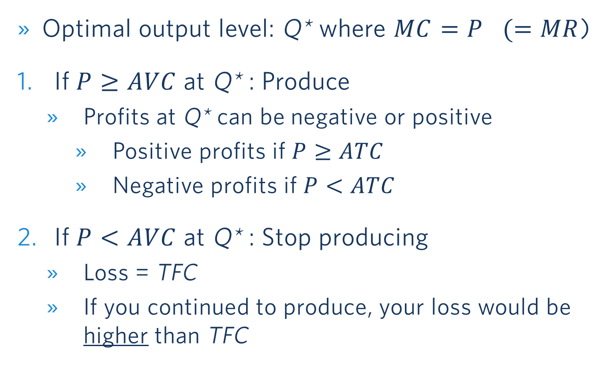
Summary: short-run decisions for a price taker
Optimal output level: Q* where $MC=P (=MR$)
If $P≥AVC$at Q* : Produce
Profits at Q* can be negative or positive
Positive profits if $P≥ATC$
Negative profits if $P<ATC$
If $P<AVC$at Q* : Stop producing
Loss = TFC
If you continued to produce, your loss would be higher than TFC

Slide 40
Outline of module 4
Perfect competition
Profit maximization of a price taker in the short run
Firm-level and market supply
Long-run competitive equilibrium
Market distortions/regulations
Externalities

Slide 41
Price Taker’s Short Run Supply Curve
MC curve is the firm’s short run supply curve
Price
Price
MC
S
230
AVC
160
40
Q
Q
300
475
300
475
Yi Family Example
Notes:
A price taker’s supply curve. We can trace out the supply curve of the firm.
At P=160, you maximize profits by producing 300 tons.
At p=230, you expand more.
Bottom line: The MC curve is the firm’s short run supply curve. We can draw the supply curve.

Slide 42

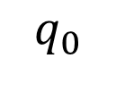
The Effect Of Changing Marginal Costs on a Price Taker’s Supply
MC
$
MC’
P = MR
High-yield
seeds
q
$$q_{0}$$
$$q_{1}$$
Notes:
Example: the Yi family starts using new high-yield seeds

Slide 43



Firm and market dynamics when MC falls
New high-yield seeds arrived on the market
Market
Firm (farmer)
P
P
MC
MC’
S
S’
P
P
P’
P’
D
Q
q
Q
Q’
$$q_{0}$$
$$q_{2}$$
$$q_{1}$$
Notes:
Now assume every farmers are using those new high-yield seeds.
First, you see the effect on the individual farmer we just saw on the previous slide. However, because all farmers face lower costs, this changes the market supply: downward shift of the market supply curve, leading to a lower market price and higher aggregate quantity.
New market price = new demand curve for the individual farmer, so that the new quantity provided by the farmer is the intersection of this new D curve with the new MC curve (MC’ and MR’). The farmer produces more than before, but less than if he/she was the only one to have the new seeds (which would be the quantity given by the intersection of MC’ and MR)

Slide 44
Outline of module 4
Introduction to market structures
Perfect competition
Profit maximization of a price taker in the short run
Firm-level and market supply
Long-run competitive equilibrium
Market distortions/regulations
Externalities

Slide 45
Perfect Competition in the Long Run
What changes?
Capital can also be adjusted
All costs are considered variable
Focus on Long Run Average Costs (LAC)
Market entry and exit
Affect the market price
Notes:
Notes from the book: because all inputs and costs are variable in the long run, the firm’s long-run supply curve is the part of its long-run marginal cost curve above its long-run average total cost curve ( LATC=LAVC because there are no fixed costs in the long run).
Yi example: in the long run they can decide whether or not to rent the land + how much land to rent

Slide 46
Long Run Competitive Equilibrium (assuming there are many identical producers)
$/Q
LAC
LMC
P₁
MR=P₁
Entry
P_{LR}
MR=P_{LR}
Exit
P₂
MR=P₂
Q
Q₂
Q_{LR}
Q₁
At Q_{LR}, P = LAC = LMC
Notes:
LAC is downward sloping because of economies of scale initially, and then upward-sloping because of dis-economies of scale. Note that this is different from ATC being down-ward sloping because of Fixed costs of a GIVEN technology.

Slide 47
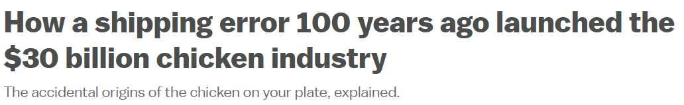

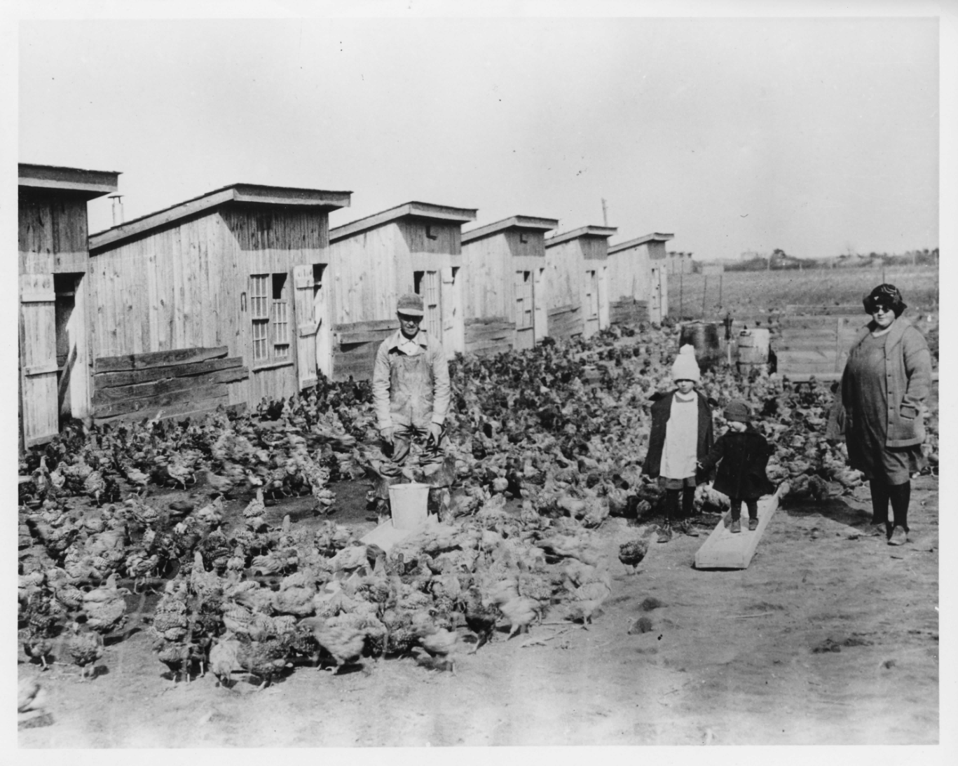
In the 1920s, farmer Cecile Steele of Ocean View, Delaware kept a small flock of chickens that she raised for eggs
In 1923, she ordered 50 chicks but, by accident, received 500. She kept them and made a sizable profit
Word of the Steele family’s success spread, and by 1928 there were hundreds of farmers in the area raising chickens to sell them for meat production
Profit in markets with low entry barriers → new firms enter
Notes:
https://www.vox.com/future-perfect/2023/2/10/23589333/cecile-steele-chicken-meat-poultry-eggs-delaware

Slide 48
Summary: long-run decisions for a price taker
Optimal output level: Q* where LMC = MR = P
If P ≥ LAC at Q*: operate
Positive profits, so other firms will enter in the long run
If P < LAC at Q* : exit the market or do not enter in the first place
Long run competitive equilibrium: LMC = P = LAC
“Normal profits”: economic profits are zero in the long run

Slide 49
Long run equilibrium: Drug market
Can we use our toolbox to analyze the (illegal) drug market?
Assume: individual drug dealers are price takers
Suppose that the government has two options to tackle the drug problem:
Arrest drug dealers (one time)
Arrest / punish drug users (one time)
Which policy is more promising if the aim is to reduce the use of illegal drugs?
Notes:
Can we characterize the drug market as a “constant cost industry?” → Yes.
Fixed cost: gun, car…
Variable cost: drugs
Same for each dealer

Slide 50

Notes:
Poll Title: Do not modify the notes in this section to avoid tampering with the Poll Everywhere activity. More info at polleverywhere.com/support To diminish the use of illegal drugs, the government should: https://www.polleverywhere.com/multiple_choice_polls/SvRjzmwXUb4CnEPPO8MVg?state=opened&flow=Default&onscreen=persist

Slide 51
Arrest drug dealers
Notes:
SR effect: More drugs supplied by remaining dealers at higher P. Profits!
LR effect: Entry → Return to old equilibrium.

Slide 52
Arrest / Punish drug users
Notes:
SR effect: Less drugs supplied by each dealer. Loss!
LR effect: Exit → Converge to new equilibrium with less drugs consumed!

Slide 53
Outline of module 4
Introduction to market structures
Perfect competition
Profit maximization of a price taker in the short run
Firm-level and market supply
Long-run competitive equilibrium
Market distortions/regulations
Externalities

Slide 54
Market distortions: Introduction
In competitive markets (i.e., perfect competition), equilibrium is given by the intersection of the supply and demand curves
External forces can distort equilibrium:
Price controls (rent control, minimum wages)
Taxes and subsidies
How to assess who benefits and who loses?
Consumer and Producer Surplus
Deadweight Loss

Slide 55
Consumer surplus
CS: difference between the consumers’ willingness to pay (D curve) and the price they pay for the product (P* )
Price
S
CS
Consumer surplus (CS) is the area below the demand curve and above the price line
P*
D
Q*
Q
Notes:
Price consumers would be willing to pay = MPV we have seen in Module 2
We can tell them to check in the textbook how to compute CS from the demand curve (triangle area) + that it will be covered by the TA

Slide 56
Producer surplus
PS: difference between the price at which producers are willing to sell (S curve) and the price producers actually receive for their goods (P* )
Price
S
Producer surplus (PS) is the area above the supply curve and below the price line
P*
PS
D
Q*
Q
Notes:
In this example PS>CS but it all depends on the relative steepness of the D and S curves
Willingness to sell depends on the producer cost structure

Slide 57
Deadweight loss
Inefficiencies that arise under market intervention
Loss of mutually beneficial transactions
E.g., workers willing to work at the market wage and firms willing to hire them, but minimum wage prevents that

Slide 58
sales tax (E.g., 10% tax on top of listed Price)
Price received by the seller (P_{S}) drops. Total price paid by the buyer (P_{B}, inclusive of tax) increases, but by less than the tax.
Price ($)
S’
S
tax (t)
P_{B}
A
B
The buyers lose A+B
The sellers lose C+D
Deadweight loss: B+D
The government gets A+C
P_{B}-P_{S}=t
P₀
t
C
D
P_{S}
D
Q
Q₁
Q₀
However, taxes on some goods (e.g., gas) can make sense due to externalities (more below)!
Notes:
Example: gasoline
The welfare losses and incidence (who pays the tax) depends on elasticities of demand and supply. For example, if supply is perfectly elastic (the supply curve is horizontal), all of the tax is paid by the consumers.
The analysis of a subsidy is similar, except the demand (or supply) curve will shift outward.

Slide 59
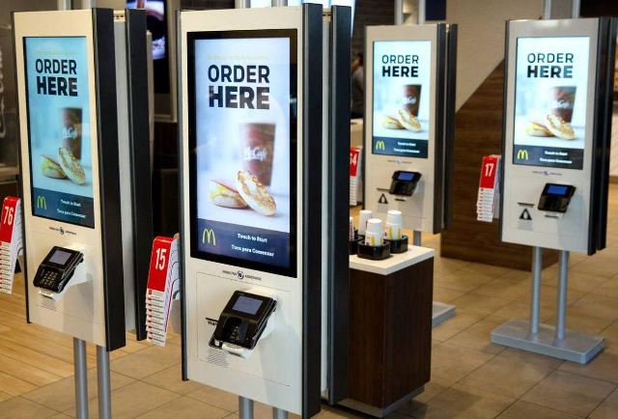
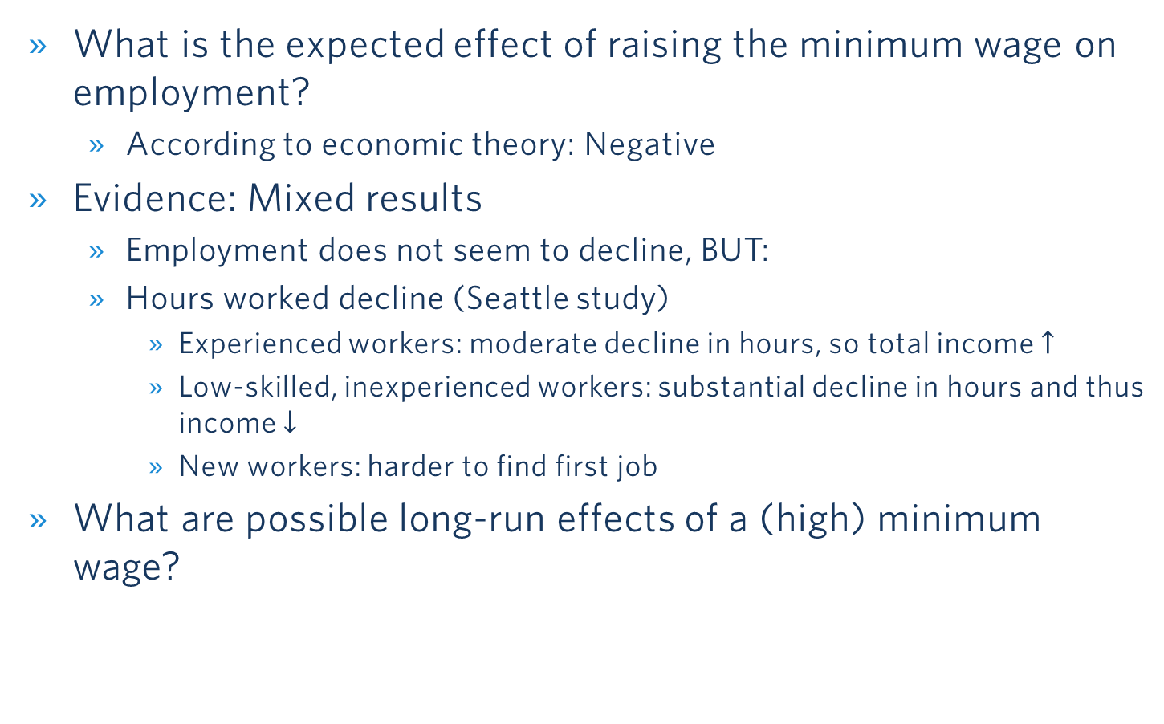
Podcast on Minimum Wage
What is the expected effect of raising the minimum wage on employment?
According to economic theory: Negative
Evidence: Mixed results
Employment does not seem to decline, BUT:
Hours worked decline (Seattle study)
Experienced workers: moderate decline in hours, so total income $↑$
Low-skilled, inexperienced workers: substantial decline in hours and thus income $↓$
New workers: harder to find first job
What are possible long-run effects of a (high) minimum wage?
Notes:
https://www.epi.org/minimum-wage-tracker/

Slide 60
Price floor: Minimum Wage
Welfare effects:
Some workers win: A
Due to higher wages
Some workers lose
Not hired anymore (C)
Firms lose A + B
Pay higher wages (A)
Hire fewer workers (B)
Deadweight Loss: B + C
Both workers and firms lose
Wage
S_{Labor}
w_{min}
A
B
w*
C
D_{Labor}
L_{d}
L*
L_{s}
Labor
L_{s}-L_{d}=unemployment

Slide 61
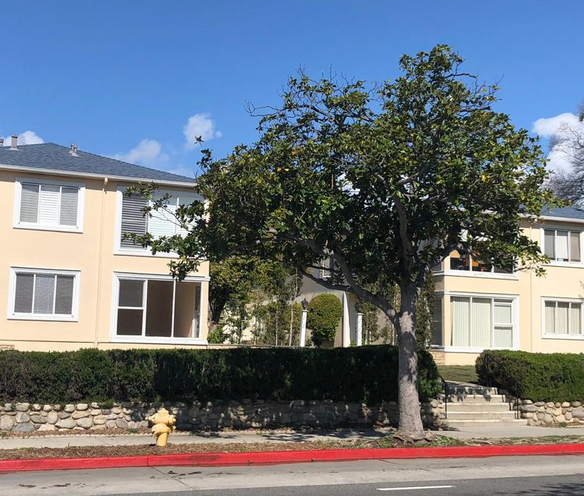
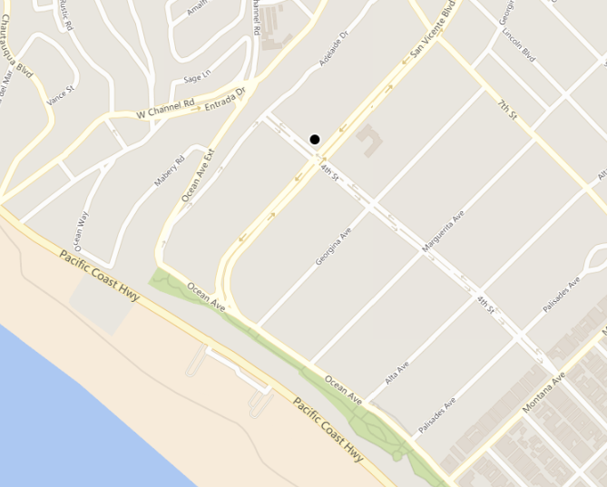
Guess the Rent!
1 Bed, 1 Bath.
900 sqft.
401 San Vicente Blvd., Santa Monica.
5-minute walk to the beach
Best public school district in West LA

Slide 62
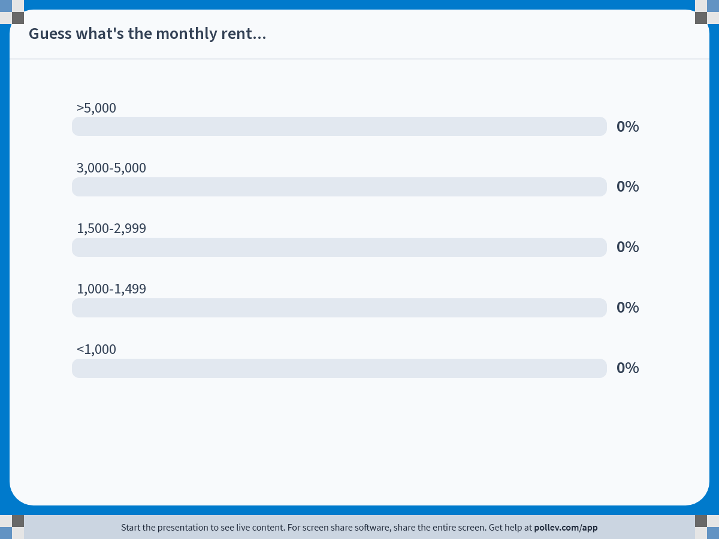
Notes:
Poll Title: Do not modify the notes in this section to avoid tampering with the Poll Everywhere activity. More info at polleverywhere.com/support Guess what's the monthly rent... https://www.polleverywhere.com/multiple_choice_polls/Ba4892DreAxLjvidjmrOV?state=opened&flow=Default&onscreen=persist

Slide 63


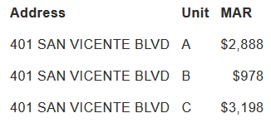
the rent is…
(rent checked on 10/22/2025)
Notes:
https://www.smgov.net/departments/rentcontrol/mar.aspx

Slide 64
Price ceiling: Rent control
Welfare effects:
Some renters win A
Those lucky enough to find/have a place
Some renters lose B
Those who can’t find a place because fewer are listed
Landlords lose A+C
A=lower rent collected
C=landlords who don’t list their flats at the lower price
Deadweight loss: B+C
P
S
B
P*
A
C
P_{max}
D
Qs
Q*
Qd
Q
Q_{d}-Q_{s}=shortage

Slide 65
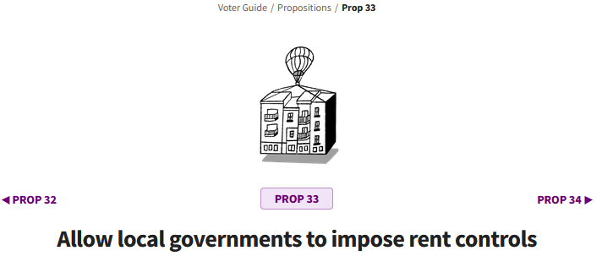
Vote on Prop 33 in California (2024)
CA imposes limits on rent control. Prop 33 proposed to reverse this. It did not pass.
Proposition 33: cities would have been allowed to control rents on any type of housing – including single-family homes and new apartments, and for new tenants.
https://calmatters.org/california-voter-guide-2024/propositions/prop-33-rent-control/
Notes:
https://caanet.org/voters-reject-prop-33-extreme-rent-control-defeated-again/

Slide 66
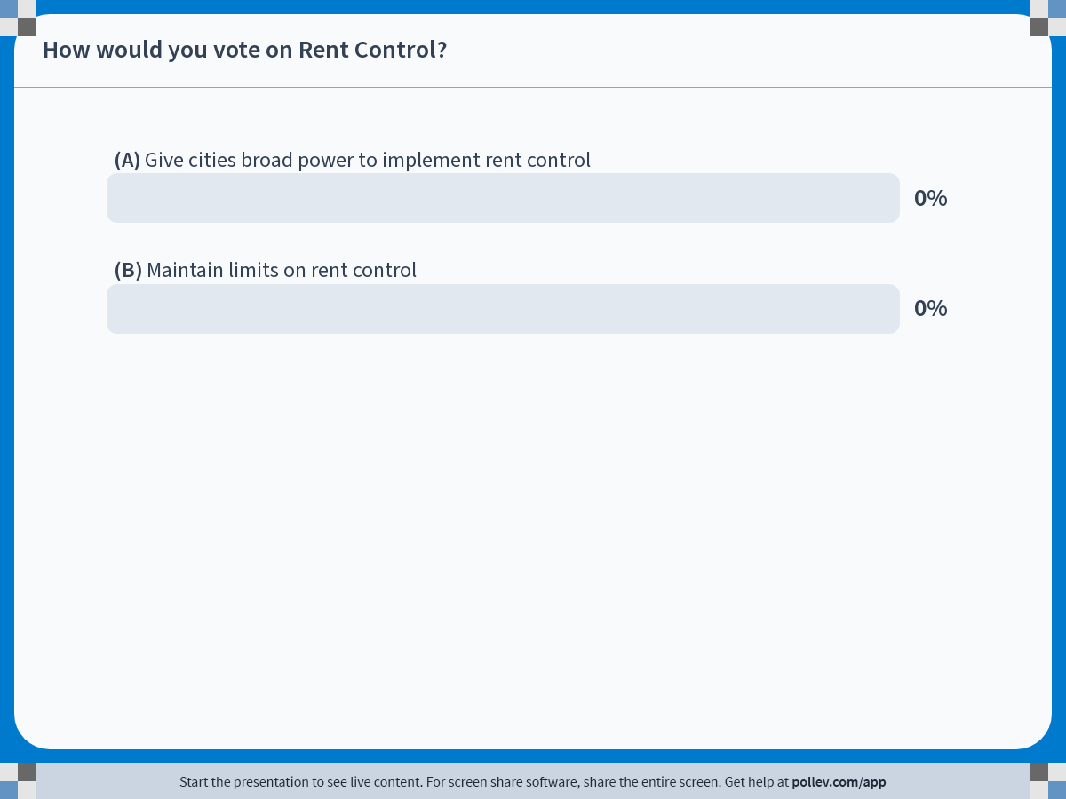
Notes:
Poll Title: Do not modify the notes in this section to avoid tampering with the Poll Everywhere activity. More info at polleverywhere.com/support How would you vote on Rent Control? https://www.polleverywhere.com/multiple_choice_polls/D2AlsqXROD7b3ZuuvOogV?state=opened&flow=Default&onscreen=persist

Slide 67
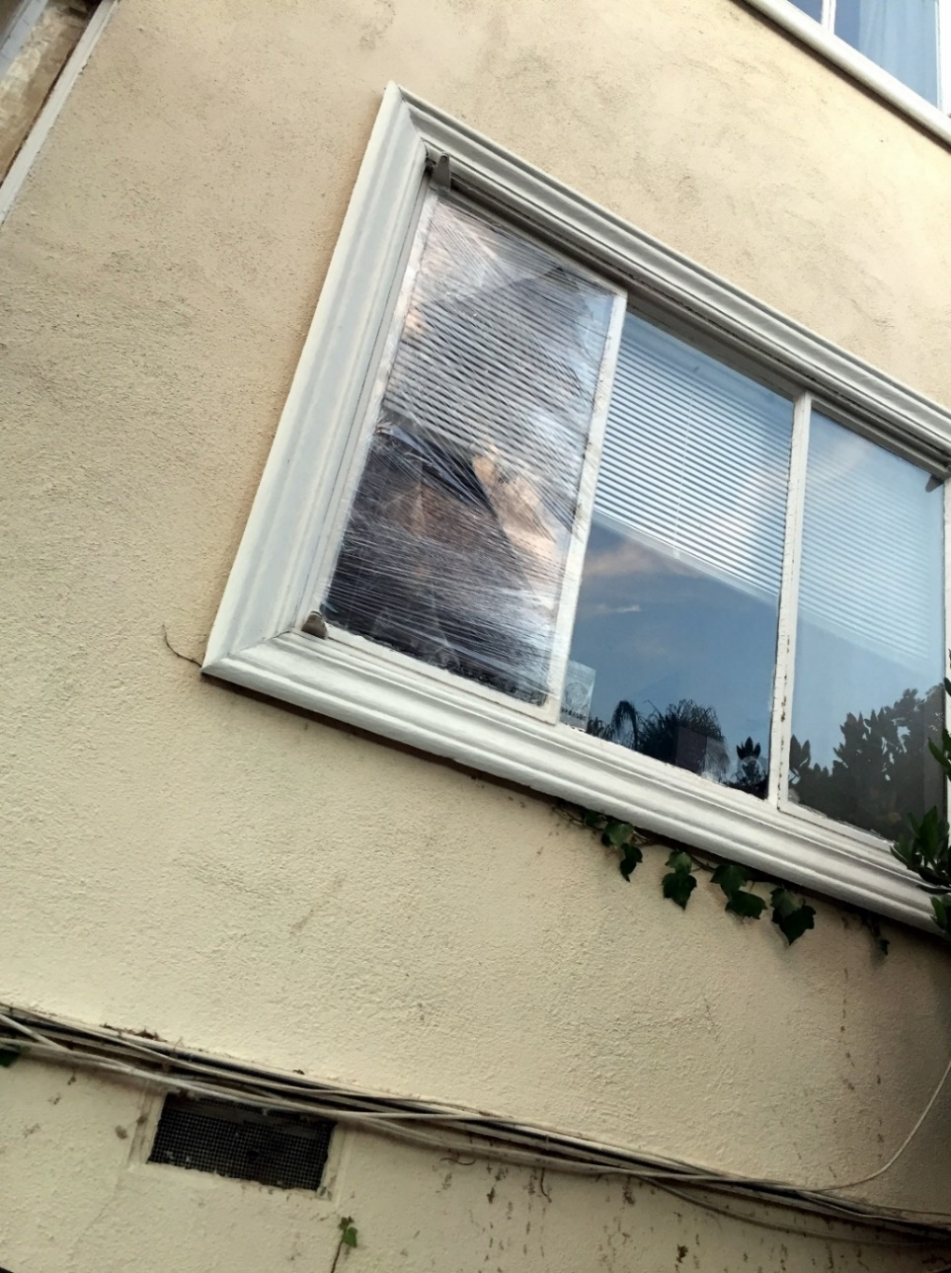

How do Landlords React to Rent control?
Non-price adjustments (e.g., neglect maintenance)
Buy out the tenants (legal)
Harass the tenants (illegal!)

Slide 68
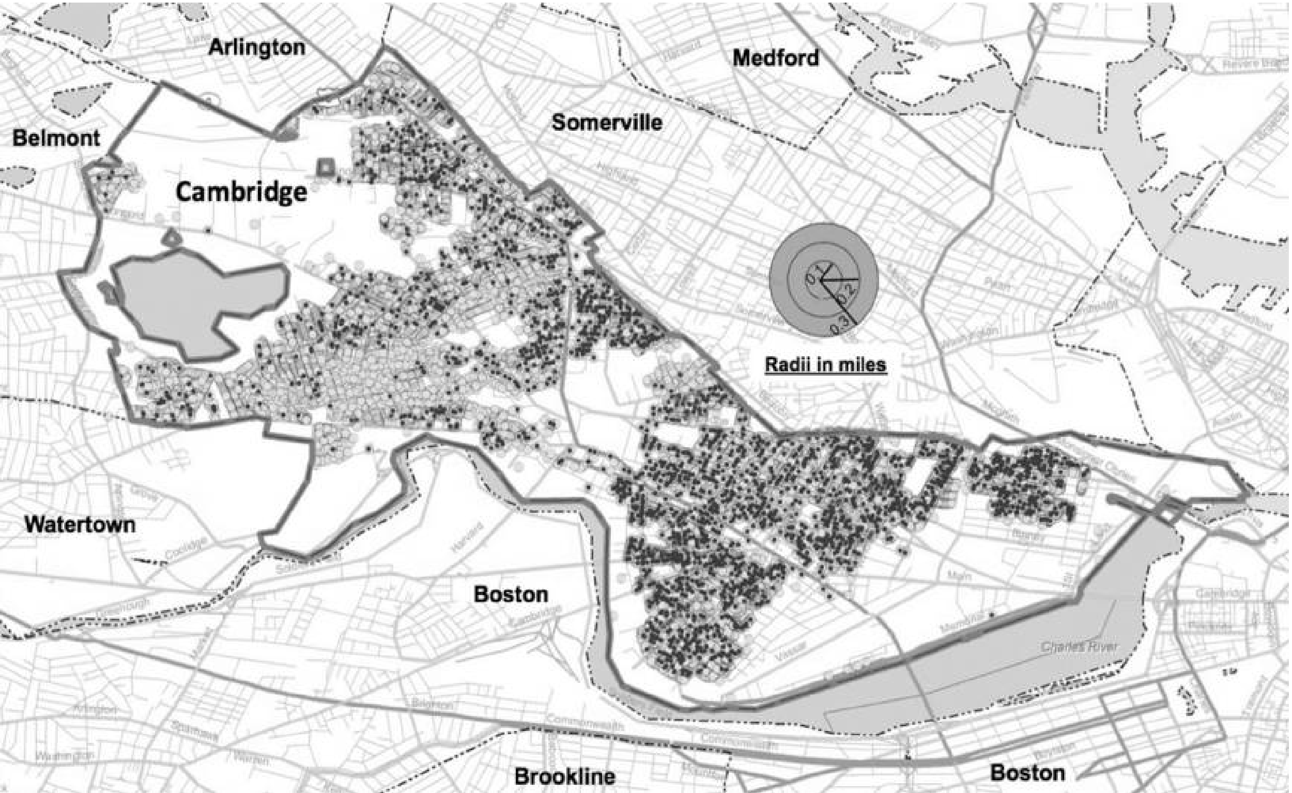
evidence on rent control
“Natural” experiment: sudden end of rent control in Cambridge, MA in 1995
Source: Autor, Palmer, Pathak (2014)
Notes:
The geography of residential properties and rent control in Cambridge, Massachusetts. Cambridge residential properties as of 2008 are marked with gray circles. Plots that were rent controlled as of 1994 are overlaid with black circles.

Slide 69
evidence on rent control
“Natural” experiment: sudden end of rent control in Cambridge, MA in 1995
What do you think happened to:
Rental price for previously rent-controlled units?
Investment in previously rent-controlled units?
Price/investment for nearby never-controlled units?
Notes:
A study on the end of rent control in Cambridge, MA finds results consistent with economic theory. When the price control is removed, the price of previously controlled units goes up, i.e. adjusts to the free market equilibrium price. Investment in these units also rises, consistent with landlords’ improvement of their units in order to command a higher price. Interestingly, the study finds that price and investment in nearby never-controlled units also rise. This is likely due to a positive spillover from the improvement in the quality of the controlled units.
For more, see the original study: https://economics.mit.edu/files/9774

Slide 70
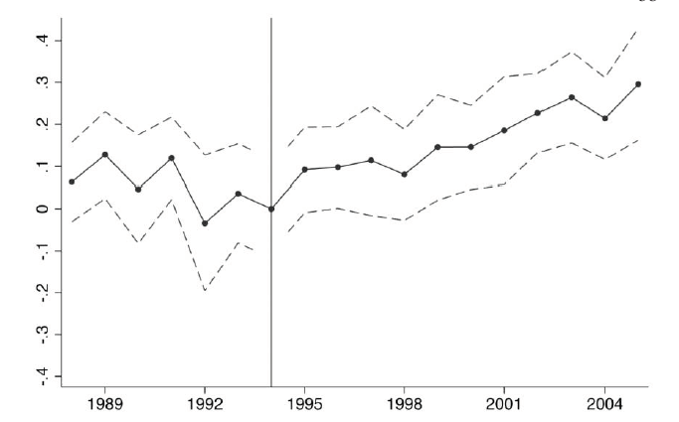
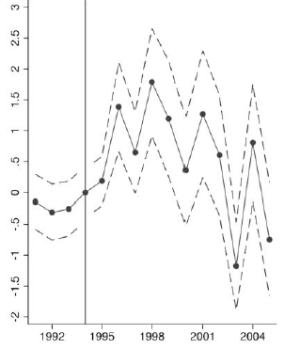
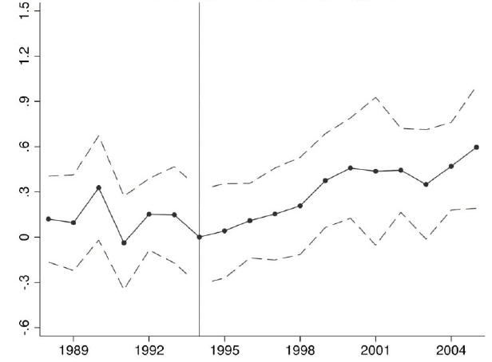
Evidence on rent controls: results
Impact on the price of decontrolled units
Impact on investment activities at decontrolled units ($1000s)
Impact on the price of never-controlled units

Slide 71
Outline of module 4
Introduction to market structures
Perfect competition
Profit maximization of a price taker in the short run
Firm-level and market supply
Long-run competitive equilibrium
Market distortions/regulations
Externalities

Slide 72
Externalities: Definitions
Externalities: A cost or benefit that affects a party not directly involved in a transaction​
Negative externality: A cost imposed on a party not directly involved in a transaction​
Air pollution from coal-fired power plants​
Neg. Externality of gasoline is approx $1.50 per gallon
Positive externality: A benefit conferred on a party not directly involved in a transaction​
Example: Your neighbor’s nice front yard is a pleasure to watch also for you

Slide 73

Externalities
Next:
How can we correct for externalities?

Slide 74
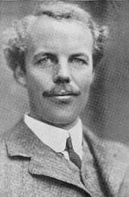
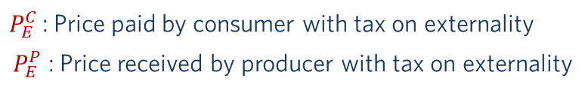



Carbon Tax to Correct for the Negative Externality
External marginal cost (“EMC”) of gasoline is $1.50 per gallon
$/gallon
MC_{I}+ EMC = SMC
(Social Marginal Cost)
Supply = Internal
marginal cost (MC_{I})
$P_{E}^{C}$ =5.5
Tax=EMC ($1.50)
Arthur Pigou
$P_{M}$=4.5
$P_{E}^{C}$ : Price paid by consumer with tax on externality
$P_{E}^{P}$ : Price received by producer with tax on externality
$P_{E}^{P}$=4.0
Demand
Quantity of gasoline per year
Q_{Ext}
Q_{Market}
Notes:
Externality of gas is approx $1.5 per gallon: https://energyathaas.wordpress.com/2015/01/05/raise-the-gas-tax/
77 countries have committed to achieving net zero emissions by 2050
Half of emissions cuts must be in place by 2030 to keep warming below 1.5°C
Carbon taxes have been implemented (or scheduled) in 46 countries
$44 billion raised in carbon pricing revenues in 2018
But this is not enough
Covers only 20% of emissions
No carbon tax in the US nor in China…
Incentives for Coal countries to burn their coal even faster now, before regulation goes into effect
Other ways of limiting emissions?

Slide 75

Externality: Airplane Noise

Slide 76
Pigouvian Tax to Correct for Noise? The case of Santa Monica Airport
Price
“Corner solution” with Q*=0
→ shut down the airport
MC_{I}+Tax = SMC
(social marginal cost)
Noise pollution (“EMC”)
Noise Tax=EMC
Pilots’/ executives’
(internal) MC_{I} of flying
D (MB of
Flying)
Q*
Flights per day
Q_{current}

Slide 77
Module 4 summary
Perfect competition: price taker, MR=P
Profit maximization: MC=MR=P → Q*
Decision to operate in the short run
Operate if P ≥ AVC
Shut Down if P < AVC
Decision to operate in the long run
Operate if P ≥ LAC
Exit/do not enter if P < LAC
Long run competitive equilibrium: P = LMC = LAC
Market distorsions: price controls, taxes
Winners, Losers, Deadweight loss
Externalities and how to correct them
Pigou tax

